Slide 1
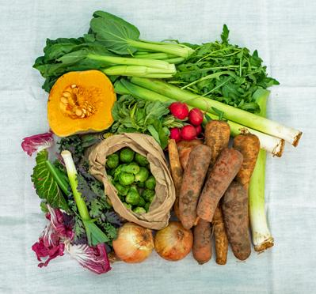
Growing Communities
Kerry Rankine

Slide 2
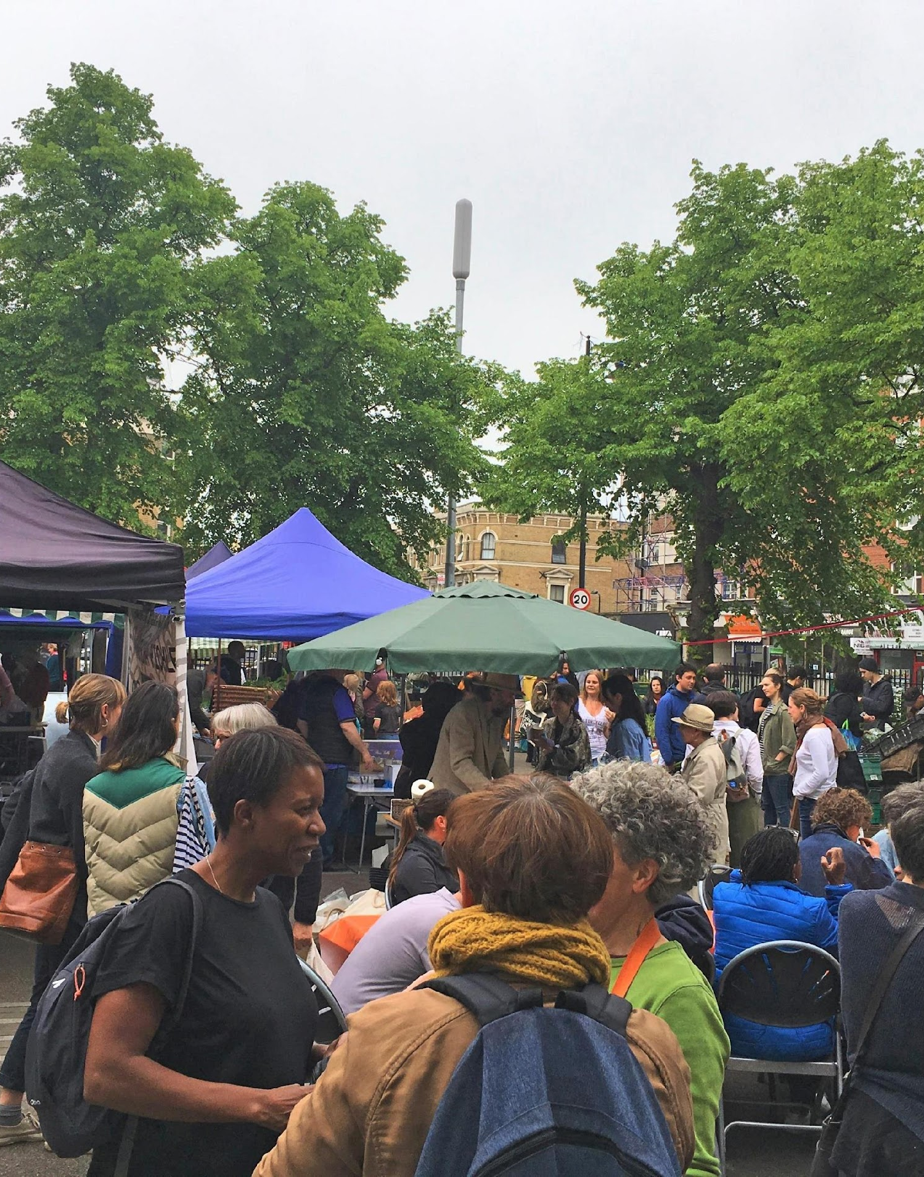
Who we are
Growing Communities is a community-led food business based in Hackney set up in 1996 – with a turnover of £2.5 M

Slide 3
Growing Communities’ core trading outlets
Growing Communities’ community-led veg scheme, set up in 1996
Growing Communities all-organic farmers’ market set up in 2003
Between them those two trading outlets now feed around 8,500 people a week in Hackney & Haringey and support 23 farmers and growers from Kent, Essex, Sussex and Cambridgeshire & beyond).

Slide 4
In 2019 we set up the Better Food Shed – a wholesale operation as a direct intervention in the supply chain to link small/medium sustainable producers with small ethical retailers and veg schemes.

Slide 5
Better Food Traders
Better Food Traders set up in 2020 but based on the community-led veg box schemes we mentored from 2010 onwards in our Start-Up Programme
Now operates independently
The network works across the UK to support and promote ethical food businesses who sell locally grown, nature-friendly food.

Slide 6
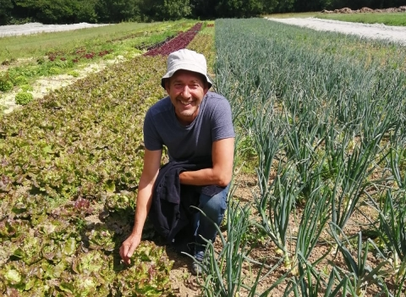
"The ethos of the Better Food Shed guarantees me and my employees an honest price for our produce. Their wages have gone up and my income has gone up as well.”
Growing Communities’ wholesale arm: the Better Food Shed – a not-for-profit organic wholesaler
Serving London’s community-led veg box schemes & local authorities
Distributing 20 tonnes of fresh organic produce weekly sourced directly from small/medium organic farmers
Farmer-focused: buying what the farmers have in the fields

Slide 7
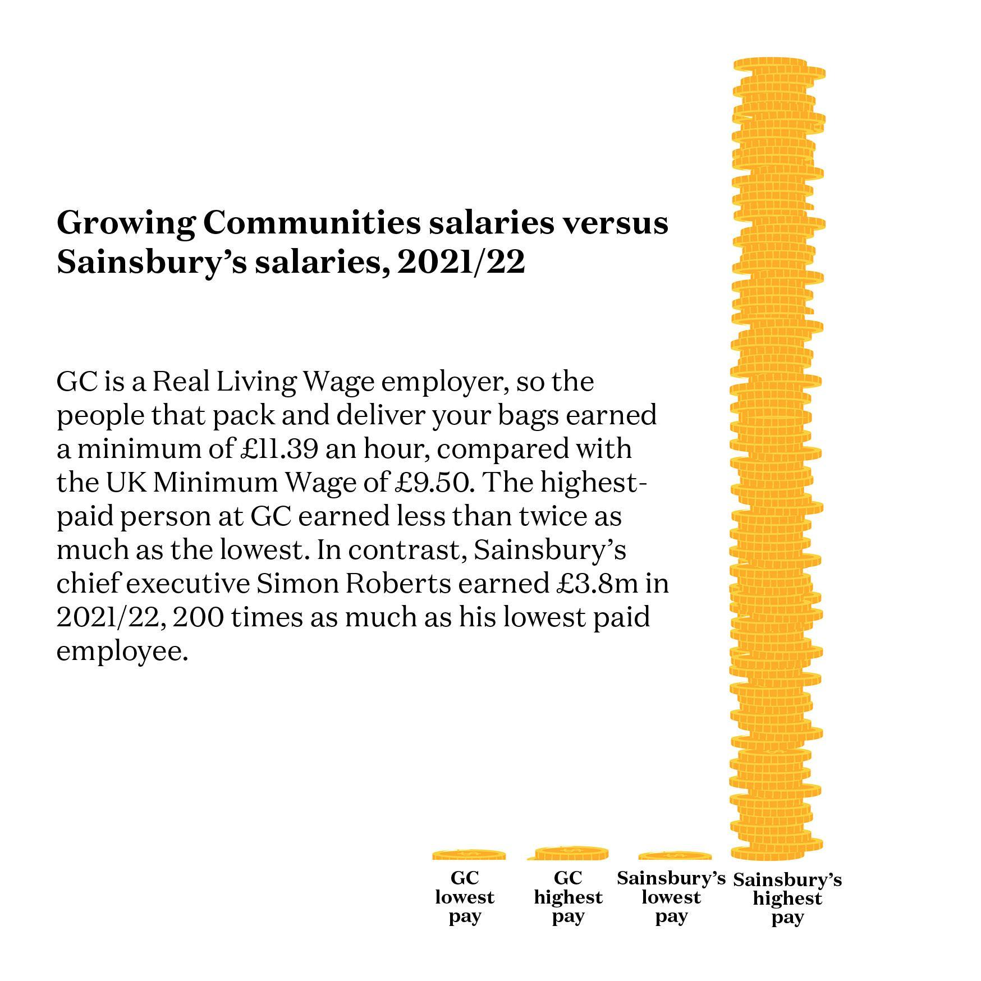

Slide 8
How we re-distributing value in the food system
Fair pay to farmers
Flexibility – take what’s in the fields
Prompt payment to farmers
Marketing by veg schemes to build customers understanding & support
Low overheads
Low operating costs
Fair pay for staff (Real Living Wage)
Low pay differential within GC (and BFS) = Not taking lots of money out of the system)

Slide 9
A report from the New Economic Foundation (in 2021) on Growing Communities veg scheme and market showed that for every £1 a customer spends with us, at least £3.70 worth of social, environmental and economic benefits are generated.

Slide 10
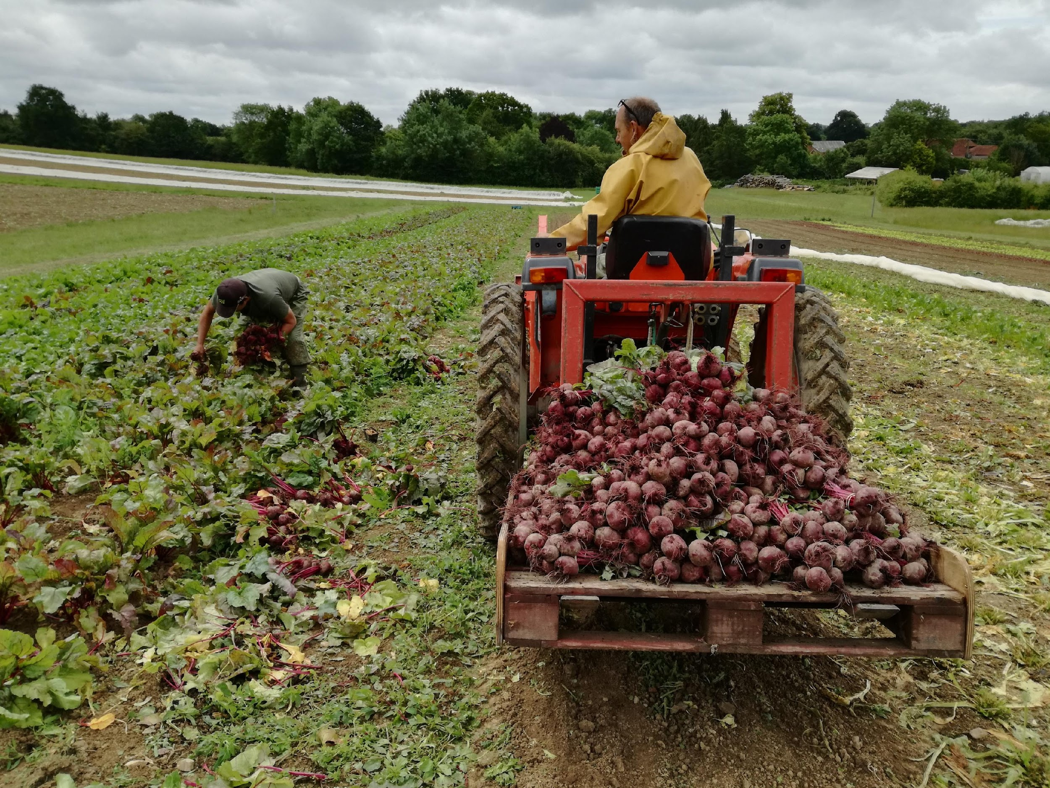
NEF also found that farmers get 50% of the sales price when they sell their veg through GC – that’s 3 times more than they would get in the global supermarket system.

Slide 11
The NEF report also shows
Buying organic food through GC creates secure, local, Living-Wage jobs in London and rural areas.
85% of GC’s farmers report increased turnover since working with GC.
These farmers employ 4 more people on average because of working with GC.
They pay good wages, benefits & support their rural communities – creating more community wealth AND create less waste.
85% of GC customers eat more seasonal produce and less processed food & less meat than they did before – and they generate LESS food waste.

Slide 12
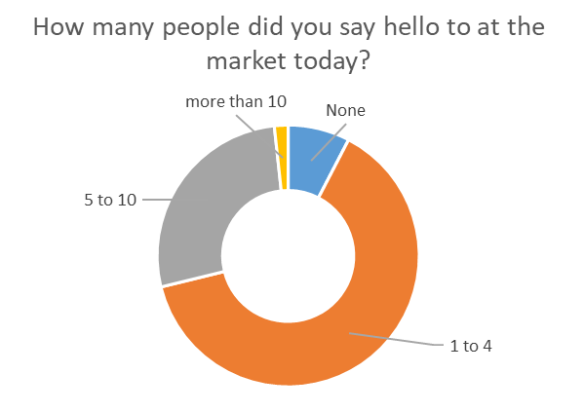

Slide 13
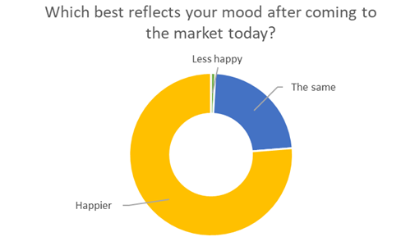
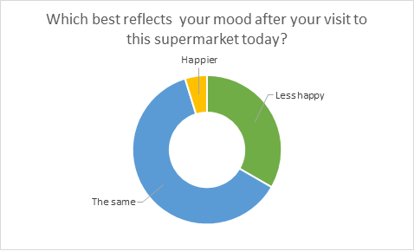

Slide 14
SURVEY/MAP WHAT IS ALREADY THERE
INFRASTRUCTURE – SPACES & PLACES & STUFF
SUBSIDY aka INVESTMENT - EG.SOCIAL RENTS
PLANNING
PROCUREMENT POLICIES
WHAT COUNCILS CAN DO

